Slide 1

JLLAR: A Logging Recommendation Plug-in Tool for Java
Jing Zhu, Guoping Rong, Guocheng Huang
Oct.29th, 2019
151250211@smail.nju.edu.cn
Notes:
Ladies and gentlemen, good afternoon. It’s great pleasure indeed for me to be able to attend this meeting. Today, I would like to present my paper “JLLAR: A Logging Recommendation Plug-in for Java”.

Slide 2
01
Background
02
Motivation
03
Our Work
04
Result
05
Discussion
06
Conclusion
Notes:
My presentation will cover these six parts.

Slide 3

Background-Logs and Log Analysis
1
Logs are the execution results of logging statements in software systems after being triggered by various events, which is able to capture the dynamic behavior of software systems during runtime.
2
Logs are extremely valuable for software developers and testers to diagnose failures both in testing environment and production environment.
3
Logs and log analysis have attracted more and more attention in both academia and industry.
Notes:
In the first part of the report, I’m going to begin with several terminologies commonly adopted in this paper.
Logs are the execution results of logging statements in software systems after being triggered by various events, which is able to capture the dynamic behavior of software systems during runtime.
A variety of software engineering tasks with diverse purposes depend on logs and log analysis, for example, debugging, monitoring, auditing, defect prediction and so on. In particular, logs are extremely valuable for software developers and testers to diagnose failures both in testing environment and production environment. Sometimes it is the only way for software engineers to deal with production failures.
As modern software systems are becoming more and more complicated and prone to evolution, rendering big challenges for software engineers to maintain these software systems, logs and log analysis have attracted more and more attention in both academia and industry.

Slide 4
Background-Logging Practice
1
A a common programming practice in modern software development, by inserting logging statements in source code in order to record runtime information when being triggered.
2
Where to log? The context of logging statements
3
What to log? The content of logging statements
Notes:
Logging practice is a common programming practice in modern software development, typically issued by inserting logging statements in source code. The importance of logging practice has been widely recognized in industry. In real-world production, software engineers need to record the error or warning information and the information indicating the success of an event as well so as to establish an understanding to the dynamic behavior of software systems.
The context of logging statements (where to log?) and the content of logging statements (what to log?) are two most concerns when conducting logging practice in software development.

Slide 5
Background-Problems
1
To be useful, logs generated by logging statements in the source code should be well-formed and informative, which requires the corresponding logging practice to be carried out properly.
2
It’s normally difficult to make sound decisions to determine the context of logging statements (where to log?) and the content of logging statements (what to log?).
3
Lack of practical guidelines to carry out logging practice.
Notes:
The problems are:
To be useful, logs generated by logging statements in the source code should be well-formed and informative, which requires the corresponding logging practice to be carried out properly.
But, it is normally difficult to make logging decisions, which mainly relies on developers’ personal skills, expertise and preference, rendering several problems impacting the quality of the logs inevitably, especially in those software projects with relatively large number of participants.
Several studies list several bad logging practices including not using log statements, missing log statements at key locations, inappropriate use of log statement levels, and lack of parameter information, etc. Another study based on open source project indicate that logging practice is usually not consistently conducted across the whole software system in most projects and some projects are extremely low-level in terms of the density of logging statements, rendering questionable satisfaction of the primary purpose of logging practice, i.e., to capture the dynamic behavior of software systems during runtime.
It seems that lacking of practical guidelines to carry out logging practice is one of the reasons for the above phenomenon.

Slide 6
Motivation
1
To help software developers normalize logging practice and guarantee some well- recognized best practices on logging practice be fully implemented.
2
Design and implement basic rule set derived from some well-recognized best practice on logging practice.
3
Apply machine learning technology to identify actual context for logging statements in actual software projects so as to further refine the rule set.
Notes:
In order to address these problems, we designed and implemented a plug-in tool, namely JLLAR to help software developers normalize logging practice.
To do this, a build-in rule set is applied in JLLAR, which is derived from some well-recognized best practice on logging practice.
We also applied machine learning technology to identify actual context for logging statements in actual software projects so as to further refine the rule set.

Slide 7
Our Work -Basic Rule Set
We retrieved the literatures included in a SLR ( Systematic Literature Review ) study and extracted the content related to either best practices or anti-patterns related to logging practice. Then we manually we evaluate, convert, and filter these extracted results and establish a basic rule set.
Table: Basic Rule Set
Target | Rule Description
Logging framework | Using logging statement instead of system.out or system.err.
Context of logging statement | Assertion needs to be logged.
 | Exception needs to be logged.
 | Logical branch needs to be logged.
 | Return value check needs to be logged.
Content of logging statement | Using error or higher level when logging exception.
 | At least one variable should be contained.
It depends. There seems no simple solution.
Notes:
In this part, I’m going to introduce our work.
There are several well recognized best practices to address issues related to logging practice in published literatures and technical blogs. To collect these practices as comprehensively as possible, we retrieved the literatures included in a SLR ( Systematic Literature Review ) study and extracted the content related to either best practices or anti-patterns related to logging practice. Then we manually we evaluate, convert, and filter these extracted results and establish a basic rule set as shown in this table.
Basic rules provide a foundation for logging recommendation, however, real-world projects might take a different logging placement strategy in production environment, especially for these two rules.

Slide 8
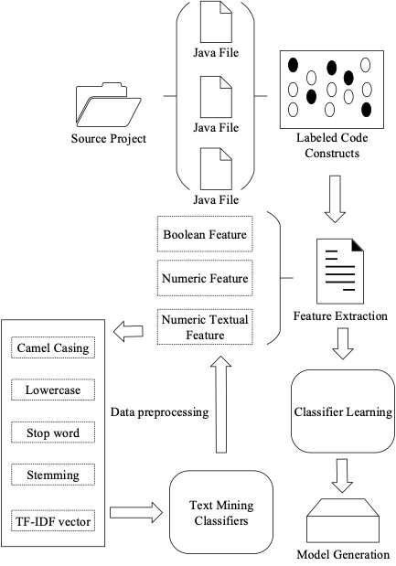
Our Work -Refine Rule Set
We adopted machine learning technology to study the situation and context in real-world software projects. Based on the model derived from machine learning, we refine the rule set. The main steps of this process are as follows:
2
1
1
Choose real-world software projects.
3
2
Access and tag each logging code block.
3
Extract features and convert text features to digital text features.
4
4
Classifier learning with different algorithms.
5
5
Generate, cross-project test and evaluate models.
Figure: Process of Model Training
Notes:
Since there seems no simple solution to this issue, we adopted machine learning technology to study the situation and context in real-world software projects. Based on the model derived from machine learning, we refine the rule set to recommend logging practice better.
This figure shows the main steps of this process:
1. choose several real-world software projects as sources.
2. access and tag each logging code block.
3. extract features of these code block and convert text features to digital text features.
4. classifier learning with different algorithms.
5. generate, cross-project test and evaluate models.

Slide 9
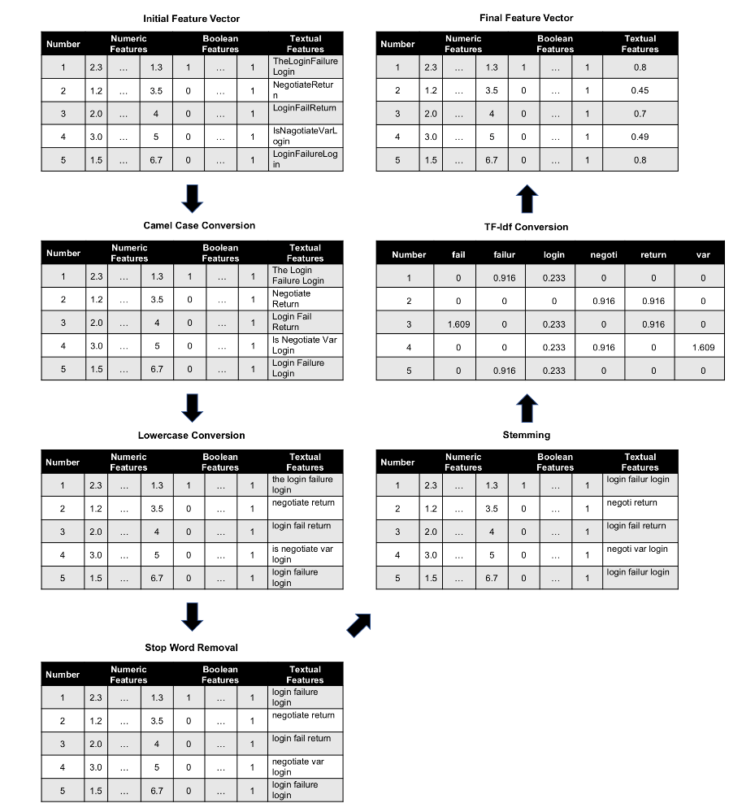
Our Work -Refine Rule Set
We using the Java parser for feature extraction, the obtained features are divided into three types, digital features, boolean features and text features. Then we convert text features to digital text features through a text mining classifier.
Table: Features
Fearure | Domain | Type
Size of Try Block | Try/Catch | Numeric
Size of Method BT | Method BT
……
Catch Exception Type | Try/Catch | Textual
Logging Level in Catch Block | Try/Catch
……
If in Try | Try/Catch | Boolean
If in Method BT | Method BT
……
Figure: Process of Digital Text Features
Notes:
In the third step, we finally obtained a total of 46 features, as is shown in the right table. These features can be divided into three types, including digital features, Boolean features and text features.
Text feature is the most important feature and needs to be convert for training. The right figure shows the process that we convert text features to digital text features.:
1. separate the text features according to the hump naming rules.
2. convert all words to their lowercase.
3. remove stop words like "the" and "is".
4. convert all words into their root forms.
5. convert all words into their TF-IDF representations.

Slide 10
Our Work -Refine Rule Set
It can be seen from the comparison results of the indicators that the prediction effects of the algorithms are not much different. Under the comprehensive comparison, the indicators of the random forest model are slightly superior, and the AUC index is significantly higher.
Table: Evaluation of Indicator Results of Models
Algorithm | Prediction | Recall | F-measure | Accuracy | RA
Adaboost | 0.982 | 0.314 | 0.476 | 0.825 | 0.695
SVM | 0.979 | 0.311 | 0.472 | 0.824 | 0.769
Naive Bayes | 0.959 | 0.313 | 0.476 | 0.823 | 0.766
Random Forest | 0.987 | 0.317 | 0.476 | 0.825 | 0.786
Logistics Regression | 0.975 | 0.313 | 0.474 | 0.824 | 0.766
Notes:
In the last step, we get the results as shown in the table. It can be seen from the comparison results of the indicators that the prediction effects of the algorithms are not much different. Under the comprehensive comparison, the indicators of the random forest are slightly superior, and the AUC index is significantly higher. So we choose the random forest to generate the model.

Slide 11
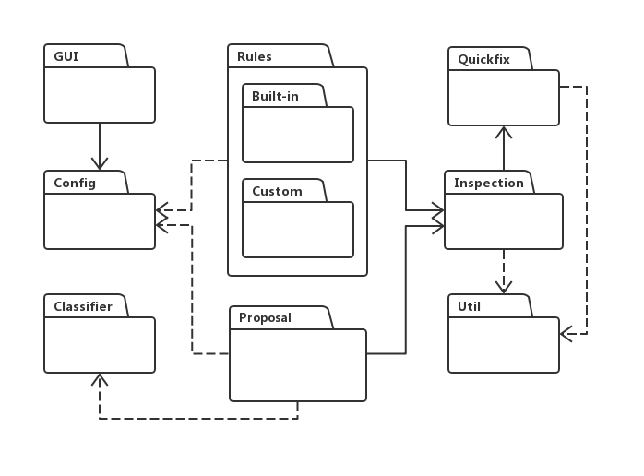
Our Work -Plug-in Development
IntelliJ IDEA is an integrated development environment for the Java programming language. It is recognized as one of the best Java development tools in the industry, especially in intelligent code assistants, code prompts, refactoring, code analysis, innovative GUI design, etc.
Figure: UI of Intellij IDEA
Figure: Architecture of JLLAR
Notes:
As is shown in the left figure, IntelliJ IDEA is an integrated development environment for the Java programming language. It is recognized as one of the best Java development tools in the industry, especially in intelligent code assistants, code prompts, refactoring, code analysis, etc. RebelLabs conducted a survey of Java tools and technologies for 2016, with 46% of developers using IntelliJ IDEA, which has exceeded 41% of Eclipse.
The architecture diagram of JLLAR is shown in the right figure, with a total of eight main modules：
1. The rules module is responsible for checking code with basic rule set.
2. The proposal module is responsible for refining some basic rules using machine learning.
3. The classifier module is responsible for model training.
4. The inspection module is responsible for scanning the code in real time and highlighting it.
5. The quick fix module is responsible for providing suggestions for modifications and automatically generating code.

Slide 12
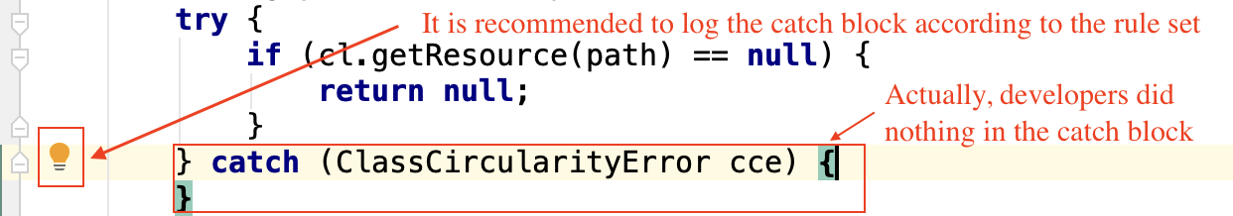
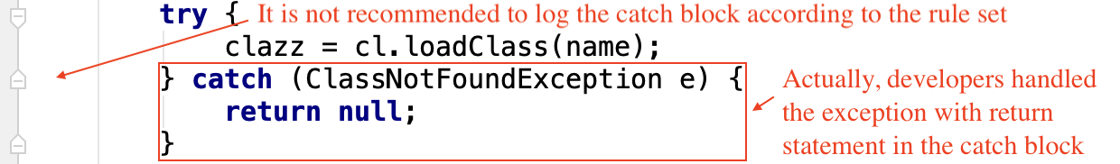
Result
After refining the rule. It wouldn’t recommend to log this catch block because the developer handled it with a return statement. Then We count and compare the number of issures in project Tomcat.
Figure: Example of Rule Refinition
Table: Result of Refination of Two Rules
Project | Rule Description | Num of Issures Before | Num of Issures After
Tomcat | Exception needs to be logged. | 784 | 152
 | Logical branch needs to be logged. | 3847 | 261
Notes:
The results are:
Taken this rule that exception needs to be logged as an example
As shown in the right two figure, it recommends to log the exception in the first figure since the developer did nothing before while it didn’t recommend to log the exception in the second figure since the developer handled the exception with a return statement.
And we count the number of issues in Tomcat before and after refining these rules. The result is shown in Table, fewer exceptions need to be logged, which is more realistic.

Slide 13
Discussion
Implication
Although the importance of logging practice is well recognized in software engineering, the implementation is far from satisfactory .
There is no simple solution to provide a “best” logging strategy.
Current logging practices often lack a comprehensive strategy.
Threats to Validity
Only involves 3 projects with Java language, which may have a limitation on generalization.
Logging practice in commercial software project differ from open source projects greatly. More investigation should be conducted with different types of software systems.
A gap may exist between the experimental evaluation and field adoption. It is necessary to carry out field evaluation on JLLAR ASAP.
Notes:
To conclude:
Our work at this stage may reveal several interesting fact around logging practice in software development:
1. Although the importance of logging practice is well recognized in software engineering, the implementation is far from satisfactory.
2. It seems that there is no simple solution to provide a “best” logging strategy. Even the same rules may have some variations in different situations.
3. Current logging practices often lack a comprehensive strategy.
At this early stage, there are several considerations and limitations about both the research process and conclusions:
1. Only involves 3 projects with Java language, which may have a limitation on generalization.
2. Logging practice in commercial software project differ from open source projects greatly. More investigation should be conducted with different types of software systems.
3. A gap may exist between the experimental evaluation and field adoption. It is necessary to carry out field evaluation on JLLAR ASAP.

Slide 14
Conclusion -Contributions
We extracted some best practices reported in relevant literature on logging practice and transformed these best practices into rules to guide logging practice.
We applied machine learning technology to further refine the rules derived from recognized best practice regarding logging practice so that these rules could be adopted as similarly as possible to the actual placement of logging statements in open source projects.
Based on the refined rule set, a plug-in tool was designed and implemented to support developers to carry out logging practice. For example, JLLAR can scan existing source code and identify missing logging statements or to insert/correct logging statement automatically.
Notes:
The main contributions of this paper can be highlighted as follows:
1. We extracted some best practices reported in relevant literature on logging practice and transformed these best practices into rules to guide logging practice.
2. We applied machine learning technology to further refine the rules derived from recognized best practice regarding logging practice so that these rules could be adopted as similarly as possible to the actual placement of logging statements in open source projects.
3. Last but not least, based on the refined rule set, a plug-in tool was designed and implemented to support developers to carry out logging practice.

Slide 15
Conclusion -Future work
JLLAR need to be evaluated in real-world software development in order to collect developers’ feedback and improve the tool.
We still need to further refine the rule set to cover more coding scenarios.
The accuracy of in the source project is about 95%, and the cross-project test also reaches 82%, but the shortcoming is that the accuracy of the logging statement level decision is only about 60%, which may be related to the choice of features, so it needs to be improved in the future.
Since more and more programing languages are applied in modern software projects, JLLAR should be improved to support different programming languages, e.g., python, go, etc.
Notes:
There are still several limitations for this study at this preliminary stage, therefore, we suggest four major topics for future work:
1. It need to be evaluated in real-world software development in order to collect developers’ feedback and improve the tool.
2. In order to solve some common problems, and finally achieve the objective of improving the quality of logging practice in software development. In the future, we still need to further refine the rule set to cover more coding scenarios.
3. The accuracy of in the source project is about 95%, and the cross-project test also reaches 82%, but the shortcoming is that the accuracy of the logging statement level decision is only about 60%, which may be related to the choice of features, so it needs to be improved in the future. 4. Since more and more programing languages are applied in modern software projects, it should be improved to support different programming languages, e.g., python, go, etc.

Slide 16
Notes:
Thank you for listening very much.

